Slide 1

RISK AND RESILIENCE BOOTCAMP
3

Slide 2


Slide 3
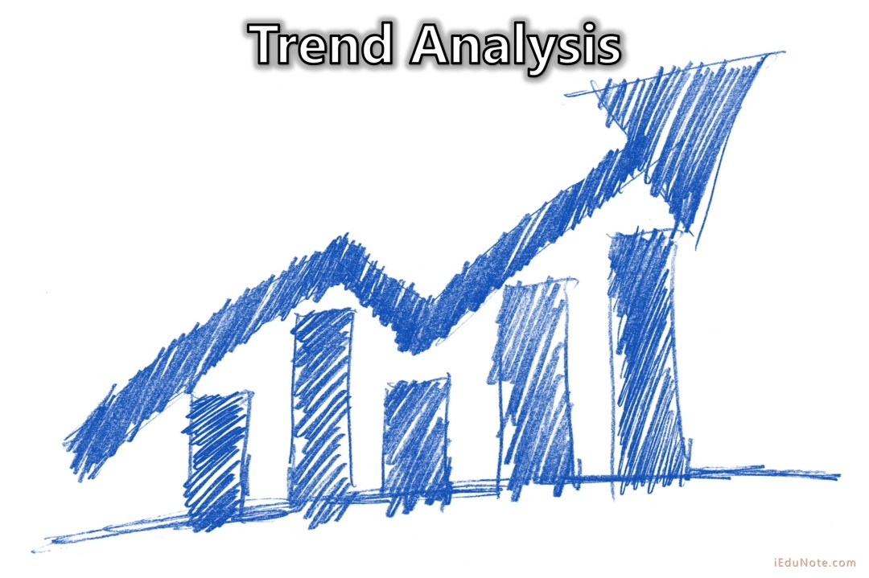
Risk Trend and aggregates
This module is an introduction to some analytics used in risk monitoring
Trend Analysis
Aggregation Analysis

Slide 4
Time series/Aggregate analysis
Monitoring longitudinal behavior, not just point-in-time metrics
Time-series approaches detect patterns, anomalies, and accumulative risks that indicate systemic vulnerabilities
Why time-series analysis matters
Identifies slow-moving, chronic failures (e.g., growing patch backlog).
Reveals seasonality or cyclical patterns (e.g., transaction spikes causing stress).
Highlights drift in performance or control effectiveness.
Provides early warnings when multiple KRIs deteriorate simultaneously.
Mature organizations aggregate metrics across:
Business units (e.g., rising access exceptions across departments)
Systems (e.g., API latency trends across microservices)
Geographies (e.g., region-wide authentication failures)
Control families (e.g., decline in detective control success rates)

Slide 5
Advanced Analytical Techniques
Moving averages /exponential smoothing
Purpose
Smooth noisy data to expose underlying trends and direction.
Example in risk monitoring
KRI: Failed login attempts per hour (indicator of brute-force attack or credential abuse)
Raw failed login counts are highly volatile
Using a 7-day moving average, a rising trend becomes visible even if daily values fluctuate
Exponential smoothing assigns higher weight to recent values, making emerging attacks easier to spot
Outcome
The SOC detects an upward directional trend in authentication anomalies
This triggers proactive controls like throttling, geo-blocking, or requiring MFA challenges

Slide 6
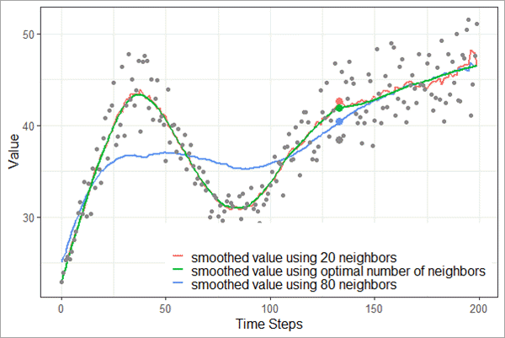
Smoothing

Slide 7
Advanced Analytical Techniques
Z-Score Normalization / outlier detection
Purpose
Identify values that deviate significantly from normal behavior
Example in risk monitoring
KRI: Outbound data transfer volume from a sensitive database
The system computes a Z-score for each hour’s outbound traffic
Z-score > 3 (three standard deviations above the mean) triggers a security alert for potential data exfiltration
Even if the transfer size is below an absolute threshold, statistical deviation flags the anomaly
Outcome
An insider threat or compromised account can be detected before significant data is lost, based solely on abnormal behavior relative to historical patterns

Slide 8
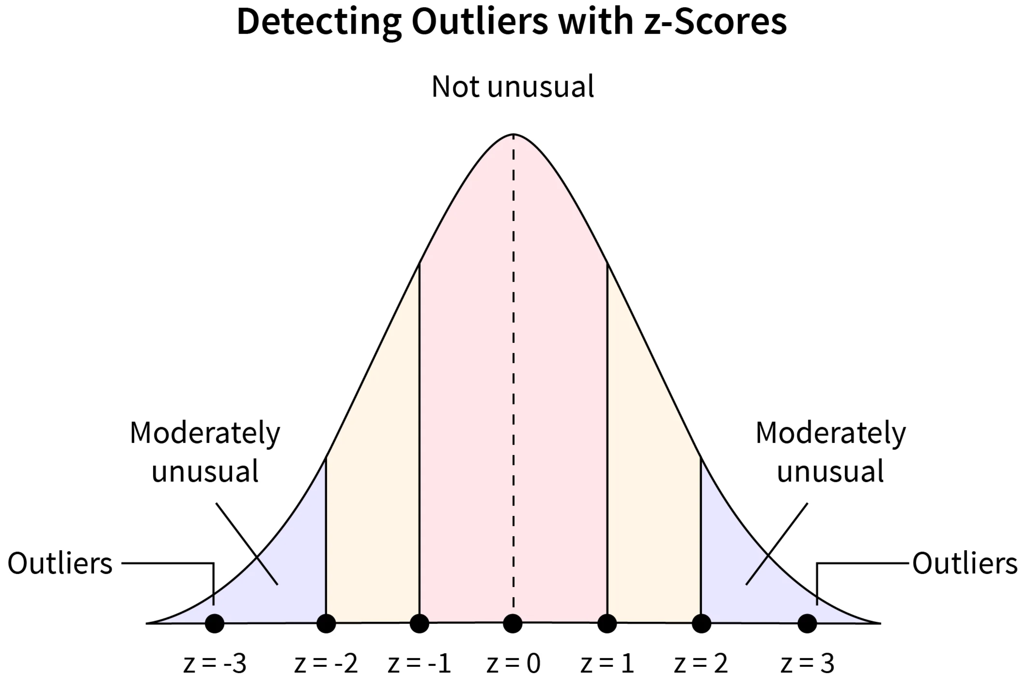
Z-Score

Slide 9
Advanced Analytical Techniques
Lag analysis
Purpose
Measure whether changes in one metric precede changes in another metric
Example in risk monitoring
KPI: Patch completion rate vs KRI: Count of critical vulnerabilities
Lag-7 analysis reveals
A decrease in patch completion today correlates with
An increase in critical vulnerabilities seven days later
Outcome
Risk teams can demonstrate a causal or predictive relationship between a KIR and heightened vulnerability exposure which strengthens the case for resource allocation or process redesign

Slide 10
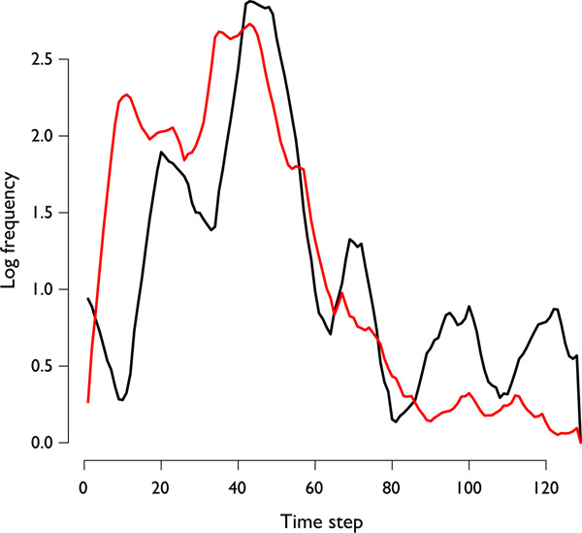
Lag analysis

Slide 11
Advanced Analytical Techniques
Cohort trend analysis
Purpose
Compare similar groups (cohorts) to find patterns or outliers within a category
Example in risk monitoring, cohorts are created by
Application type (web apps vs. batch apps)
Technology stack (Java vs. Node vs. Python)
Environment (production vs. staging)
Ownership (Team A vs. Team B)
A cohort analysis reveals
Systems owned by Team B show a 3× higher growth rate of high-severity vulnerabilities compared to similar systems owned by other teams.
Outcome
This reveals a team-specific process breakdown rather than a global security weakness suggests targeted training, staffing, or process intervention can be deployed

Slide 12
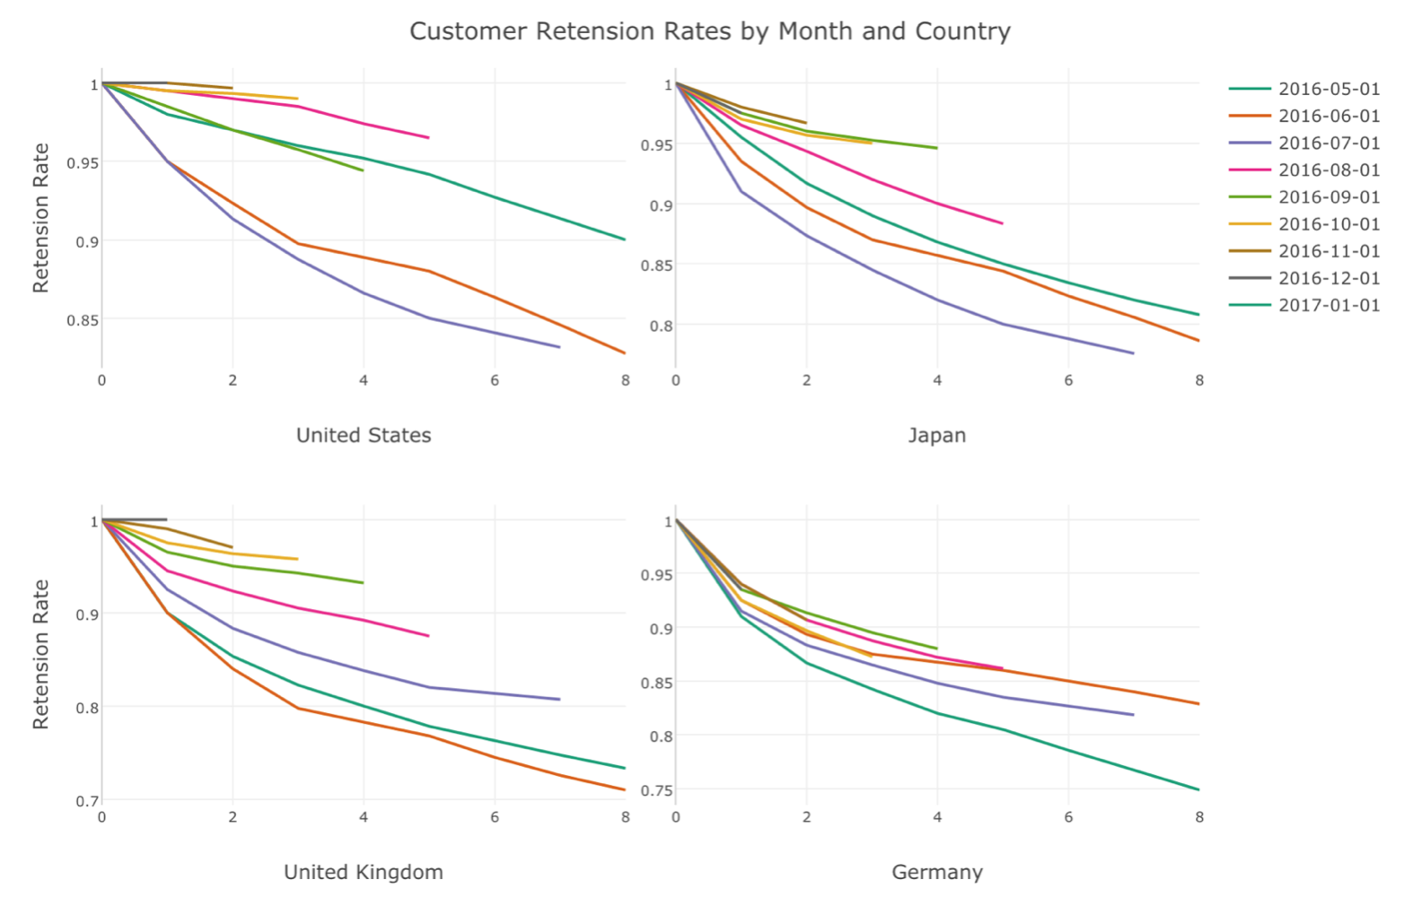
cohort analysis

Slide 13
Advanced Analytical Techniques
Cross-correlation matrices
Purpose
Identify how metrics influence each other across time.
Metrics include
KPI: Mean Time to Recover (MTTR) for incidents
KRI: Incident frequency
KPI: Change success rate
KRI: Number of repeated near misses
Cross-correlation shows
When change success rate decreases
Incident frequency increases with a correlation coefficient of 0.82
Additionally, higher MTTR correlates with a rise in repeated near misses, suggesting control inefficiency
Outcome
The correlation matrix grounds the argument that unstable change processes are the root cause of operational risk increases which should trigger major change-control reforms

Slide 14
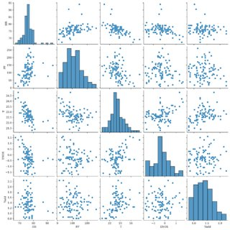
Cross-correlation matrices

Slide 15
Advanced Analytical Techniques
Composite KRI Index
Purpose
Combine disparate KRIs into a single normalized risk score that can be tracked over time
Combine KRIs such as
Number of critical vulnerabilities (weighted 30%)
Privileged access exceptions (20%)
Failed login anomalies (20%)
Backup integrity failures (15%)
End-of-life infrastructure ratio (15%)
Outcome
The correlation matrix grounds the argument that unstable change processes are the root cause of operational risk increases which should trigger major change-control reforms

Slide 16
Advanced Analytical Techniques
Composite KRI Index
Using normalized values and weights produces a Composite KRI Index (0–100).
Example trend
Q1: 42
Q2: 49
Q3: 63
Q4: 71
Even without a major incident, the index shows a clear erosion of risk posture, prompting leadership to invest in remediation before conditions worsen
Composite indices provide:
Board-friendly reporting
Cohesive trend visibility
A single metric that captures complex, multidimensional risk exposure
This enables strategic prioritization and budget planning

Slide 17

Q&A and open discussion
Notes:
Now is the time to engage in an interactive Q&A session where you can ask questions, share insights, and clarify any doubts about the topics we have covered so far.
This open discussion is designed to ensure that every participant has the opportunity to voice their thoughts and learn from the collective experience of the group.
Your questions and comments are valuable as they help us identify areas that may need further explanation and enable us to tailor future sessions to your needs.
We encourage you to speak up and contribute to the dialogue, as this interaction is one of the key components of our interactive learning approach.
As the session progresses, take note of any questions or ideas that you would like to revisit, and feel free to share your perspectives with the class.

